Slide 1
Travel and Leisure

Slide 2
Ways of travelling
How do you like travelling? By train? By plane? By coach? On foot?
Do you usually travel with your family or friends?
Where do you travel?
What do you usually do on a journey?

Slide 3
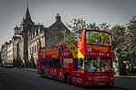
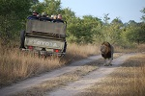
Types Of Holidays
Match the pictures to the types of holidays.
a) d)
b) e)
c)
1)Safari
2)Beach holiday
3) Cruise
4) Sightseeing Tour
5)Activity holiday

Slide 4
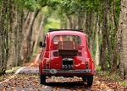
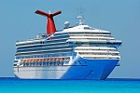
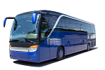
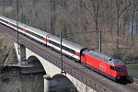
How do you like to travel?
Match the pictures to the types of holidays.
a) d)
b) e)
c) f)
1)By ship
2)By train
3) By car
4) On foot
5)By coach
6)By plane

Slide 5
Listen to the advertisement (read SB p 116- 117)
Answer the questions:
Where can you
play tennis?
have a picnic near the lake?
travel along the Nile river?
try rock climbing?
5)swim in the swimming pool?
6)learn about national parks?
7)ride a bike in the mountains?
8)go on a tour to the wild ?
9)see lots of castles?
10)have a good time indoors?

Slide 6
Listen to the advertisement again (read SB p 116- 117) and do the matching:
ex.3 b) p 116 (SB)

Slide 7
Read GR- 7
Использование глагола
Can – can’t
Do ex. 5 a)b) , ex. 6
page 116 – 117 (SB)

Slide 8
HOMEWORK
1)Слова 10 модуль учить
2) GR 7
3)WB p 71 ex 1, 2,4,5
Выслать фото до 21 часа понедельника 18 мая

