Slide 1
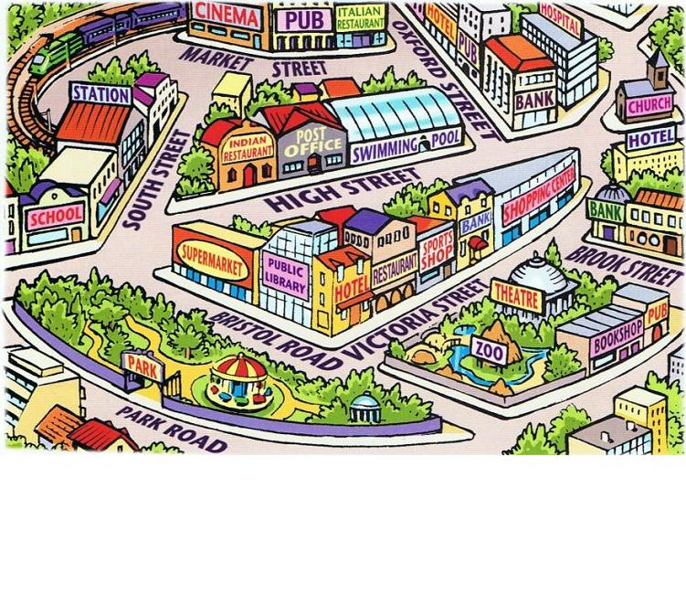
ASKING/ Giving DIRECTIONS

Slide 2
Before we start!
Make sure that you are sitting correctly.
Turn on the lights.
Get ready with your Student’s Books, notebooks and pens and homework

Slide 3
Let’s remember the words
Open your dictionary and remember the words,
Get ready with your homework

Slide 4
Where’s the thief?

Slide 5
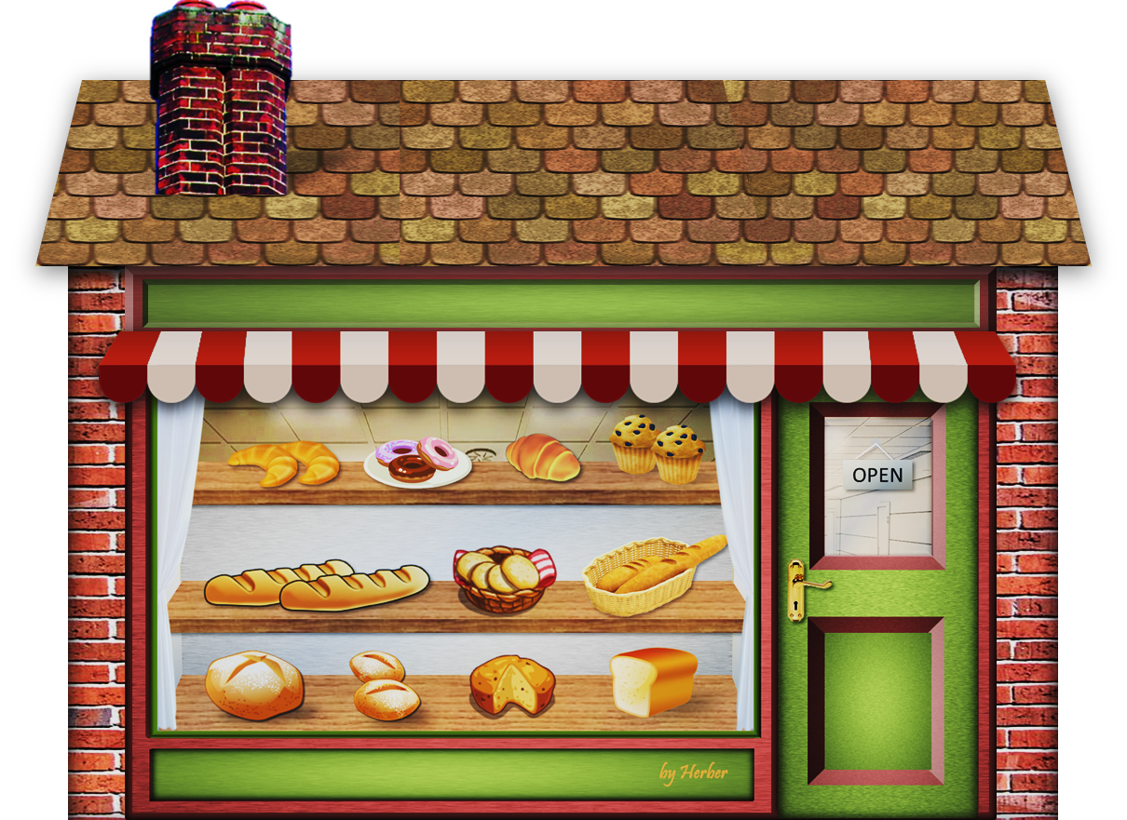
I’m going to steal some biscuits and bread.
Where is he?

Slide 6
He is in the BAKERY

Slide 7
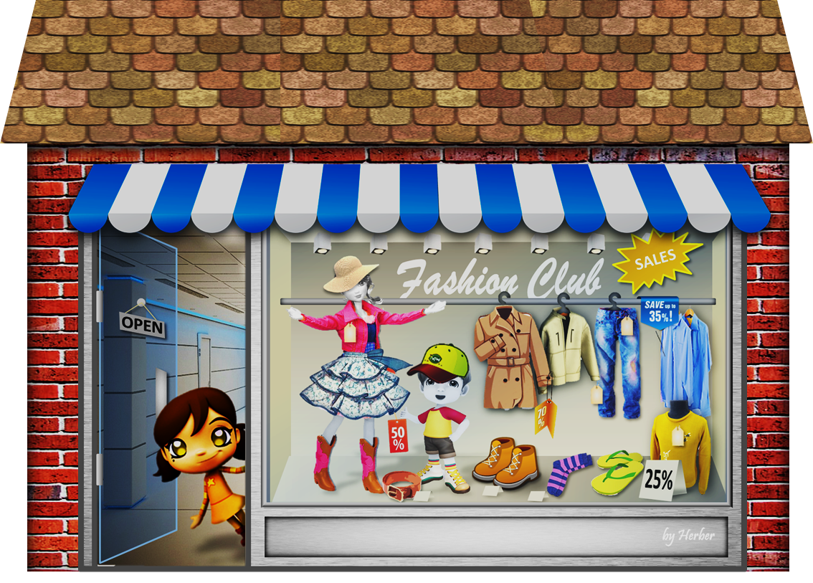
I’m going to steal some shirts and jackets.
Where is he?

Slide 8
He is in the CLOTHES SHOP

Slide 9
I’m going to steal some sculptures and paintings.
Where is he?

Slide 10
He is AT the MUSEUM

Slide 11
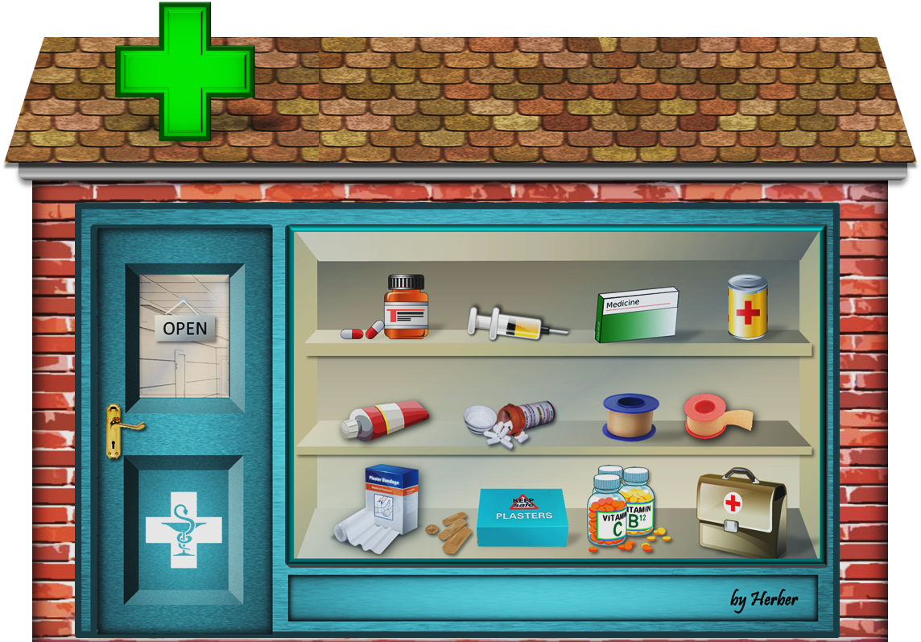
I’m going to steal some plaster and medicines.
Where is he?

Slide 12
He is AT the CHEMIST’S

Slide 13
I’m going to steal some newspapers and sweets.
Where is he?

Slide 14
He is AT the NEWSAGENT’S

Slide 15
LET’S CHECK YOUR HOME ASSIGNMENT

Slide 16
LET’S CHECK YOUR HOME ASSIGNMENT
B. Соотнесите части фраз
go next on the corner turn on your how do I get | of up / down right / left right / left to to
С.Просмотрите еще раз фильм с 3:50 до 4:40 и выпишите знаки-направления движения
1) 2) 3) 4) 5) | 6) 7) 8) 9) 10)

Slide 17
LET’S CHECK YOUR HOME ASSIGNMENT
D. Что обозначают эти знаки? Соотнесите картинки и значения.
1) 2) 3) 4) 5)
You mustn't turn left.
You mustn't use cell phones.
You mustn't take pictures.
You mustn't eat or drink here.
You mustn't feed animals.

Slide 18
Let’s check the dialogue
Teacher: Excuse me, Bob....
Bob:
Teacher:

Slide 19
Read the dialogue SB p112 ex 2. 1) (ДО 0:23) repeat together with the speaker

Slide 20
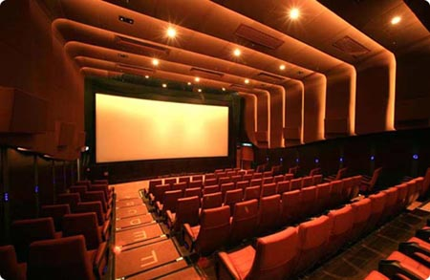
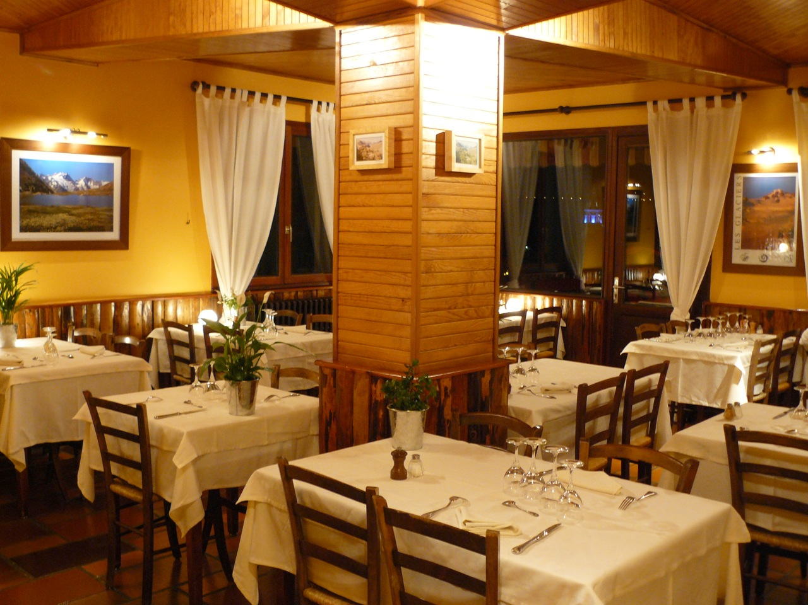
Make a short dialogue (SB p112)
( volunteers)
Excuse me, is there a _________ near here?
B. Yes, there’s one on _________Street (Road)

Slide 21
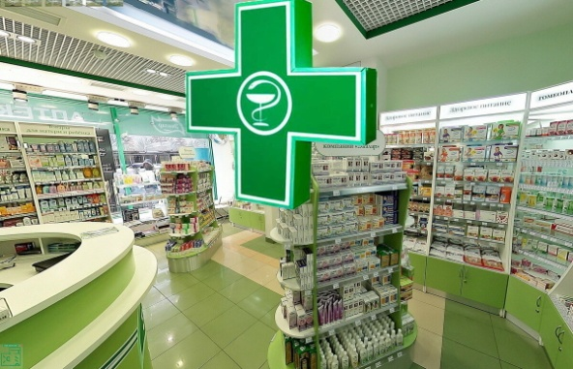
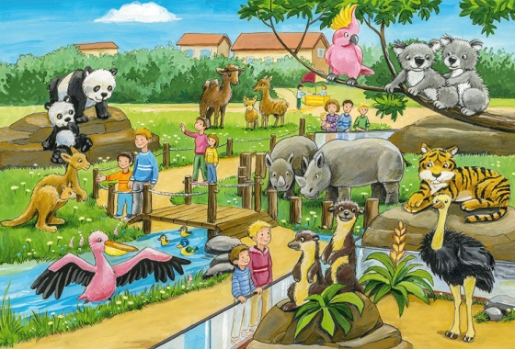
Make a dialogue according to the pattern (SB p112)
A: Excuse me, is there a _________ near here?
B: Yes, there’s one on _________Street (Road)
A: Where exactly?
B: On the corner of ________ and __________
A: Thanks a lot

Slide 22
Read SB page 112 ex 2. 2) repeat after the speaker (С 0:26)

Slide 23
Look at the picture (SB p 112) and ask your partner how to find
Bakery
Newsagent’s
Florist’s
Art gallery
Supermarket,
…

Slide 24
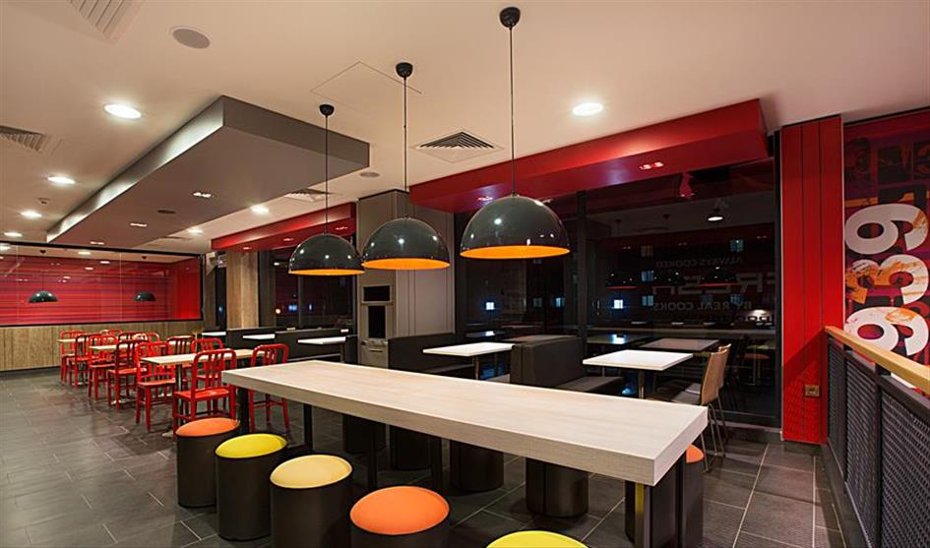
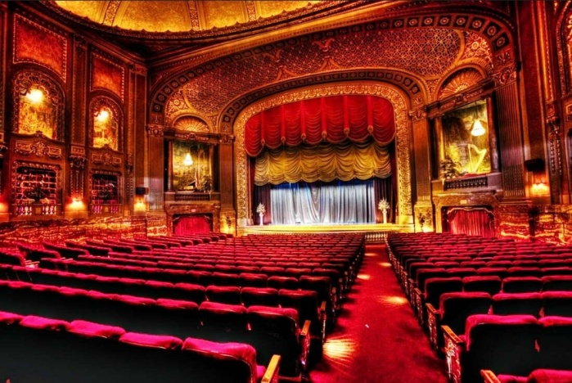
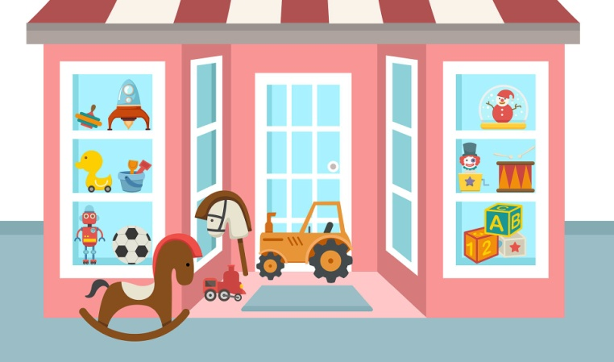
Read the dialogue using new words:

Slide 25
Ask your partner how to find…

Slide 26
HOME ASSIGNMENT
1)Слова модуль 9
2) Записи в тетради по Past Simple.
3)Составить диалог из 8 реплик на основе упр 2 стр 112 и картинки из презентации
Выслать НЕ НУЖНО

