Slide 1
Before we start!
Make sure that you are sitting correctly.
Turn on the lights.
Get ready with your Student’s Books, notebooks and pens.

Slide 2
Приготовьте, пожалуйста, чистый лист формата А4. Сегодня будем делать буклет!

Slide 3

The Earth is what we all have in common
Module 8b

Slide 4
Speaking about environment we should follow the plan
DIFFERENT
=
a lot of
=
many

Slide 5
Speaking about environment we should follow the plan
There are DIFFERENT
environmental problems.
Water
pollution
Air pollution
Soil pollution

Slide 6
Environmental problems - plan
1)
2)
3)
4)

Slide 7
Environmental problems - plan
1) Problem
2) Reasons
3) Results
4) Eco-friendly actions

Slide 8
Eco-booklet
1) A list of paper (A4)
2) 4 bending
3) 1 cut
4) 8 pages

Slide 9
Air pollution is one of the biggest problems.
It is caused by different means of transport that burn petrol. Factories and power stations emit toxic fumes. One more point is that trees absorb carbon dioxide and give out oxygen. People destroy forests by cutting down a lot of trees.
As a result, the air we breathe becomes polluted. There is no place for birds and animals to live. Harmful emissions bring acid rains, spoil the atmosphere, damage people’s health.

Slide 10
Air pollution – What can we do?

Slide 11
Air pollution – What can we do?
use alternative sources of energy
use public transport instead of cars
use eco-friendly means of transport
stop cutting woods
begin planting trees

Slide 12
Water pollution is as dangerous as air pollution.
Factories and plants and put waste into lakes, rivers , seas and oceans.
As a result, the water becomes harmful and it kills fish and plants.

Slide 13
What can we do to restore waterways back to normal?

Slide 14
What can we do to restore waterways back to normal?
-never throw anything into rivers and lakes
-stop dumping industrial waste into water
-use up-to-date filters
-develop eco-friendly industries and technologies

Slide 15
Soil pollution is no less dangerous.
Basically we must understand that anything that gets to the ground can end up in a landfill and then in a river, lake and stream.
As a result, the soil together with the air and water becomes poisonous and harmful to people. Besides, animals, birds and plants disappear.

Slide 16
What can we do to reduce pollution?
-become more eco-friendly
-stop producing so much waste
-sort rubbish and put it into special bins
-get your rubbish to a recycling center
-make nature helping school projects
-plant trees
-organize cleaning-up and recycling days
-take care of flora and fauna

Slide 17
Gymnastics
1. Close your eyes, count to 5, open your eyes. Repeat 6 times.
2. Hold your hands out in front of you, move them to the right-to the left, watch you fingers without moving your head. 6 times.
3. Without moving your head look up, look down, look left, look right. Repeat 6 times.
4.Stand straight, put your hands up, breathe in, put you hands down, breathe out. Repeat 6 times.

Slide 18
The good news is that
! Governments encourage eco-friendly industries and new technologies.
! World/National Organizations create special funds helping wildlife.
! City/School clubs, camps and projects organizing environmental awareness actions.

Slide 19
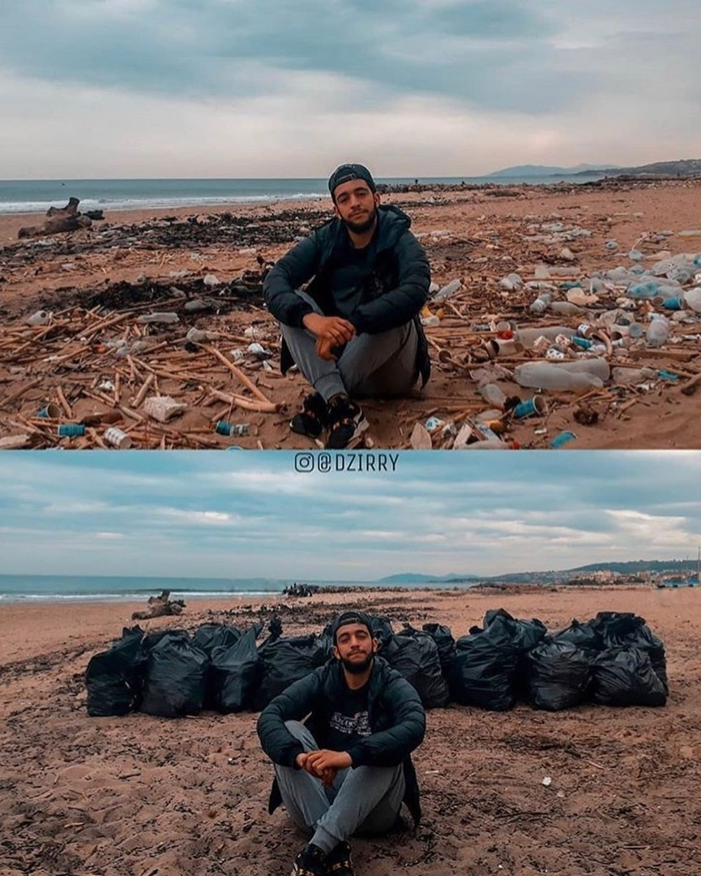
Think of a name to the picture and share your idea in the chat

Slide 20
One of the possible names:
What has the man done?
It’s not my rubbish
but it’s my planet!

Slide 21
My contribution
As for me, I …
Usually/always
Last year/month
Every winter/spring/summer/autumn
This way I try to be eco-friendly.

Slide 22

Conclusion
We all need to work together to stop the problem before it is too late!

Slide 23

It’s up to us to help it!

Slide 24
Homework
Слова модуля 8
Эко-буклет (заполнить, оформить, выслать видео с демонстрацией страниц буклета)

